Slide 1
CS 1520 COMPUTER ARCHITECTURE
Prof. Peter Edwards
p.edwards@abdn.ac.uk
Notes:
Some slides in this set adapted from:
Digital Design and Computer Architecture, 2nd Edition
David Money Harris and Sarah L. Harris

Slide 2
Finite State Machines

Slide 3
FSM Example: Paper Tape #2
The snail from our earlier example has a daughter with a Mealy machine brain.
The daughter snail smiles whenever she slides over the pattern 1101 or the pattern 1110.
Question:
Sketch the state transition diagram for this happy snail using as few states as possible.
Choose state encodings and write a combined state transition and output table using your encodings.
Write the next state and output equations and sketch your FSM schematic.

Slide 4
Paper Tape #2 - Mealy FSM
0/0
Reset
1/1
1/0
1/0
0/0
0/0
Reading State0
Reading State1
Reading State2
Reading State3
0/0
0/1
1/0
Reading State4
The daughter snail smiles whenever she slides over the pattern 1101 or the pattern 1110.
1/0

Slide 5
Paper Tape #2 - Mealy FSM
State Encoding:
State | Encoding (s_{2:0})
Reading State0 | 000
Reading State1 | 001
Reading State2 | 010
Reading State3 | 100
Reading State4 | 101

Slide 6
Paper Tape #2 - Mealy FSM
State Transition & Output Table:
Current State |  |  | Inputs | Next State |  |  | Output
S₂ | S₁ | S₀ | A | S₂’ | S₁’ | S₀’ | Q
0 | 0 | 0 | 0 | 0 | 0 | 0 | 0
0 | 0 | 0 | 1 | 0 | 0 | 1 | 0
0 | 0 | 1 | 0 | 0 | 0 | 0 | 0
0 | 0 | 1 | 1 | 0 | 1 | 0 | 0
0 | 1 | 0 | 0 | 1 | 0 | 0 | 0
0 | 1 | 0 | 1 | 1 | 0 | 1 | 0
1 | 0 | 0 | 0 | 0 | 0 | 0 | 0
1 | 0 | 0 | 1 | 0 | 0 | 1 | 1
1 | 0 | 1 | 0 | 1 | 0 | 0 | 1
1 | 0 | 1 | 1 | 1 | 0 | 1 | 0
The daughter snail smiles whenever she slides over the pattern 1101 or the pattern 1110.

Slide 7
Paper Tape #2 - Mealy FSM
Derive Next State Logic:
Current State |  |  | Inputs | Next State |  |  | Output
S₂ | S₁ | S₀ | A | S₂’ | S₁’ | S₀’ | Q
0 | 0 | 0 | 0 | 0 | 0 | 0 | 0
0 | 0 | 0 | 1 | 0 | 0 | 1 | 0
0 | 0 | 1 | 0 | 0 | 0 | 0 | 0
0 | 0 | 1 | 1 | 0 | 1 | 0 | 0
0 | 1 | 0 | 0 | 1 | 0 | 0 | 0
0 | 1 | 0 | 1 | 1 | 0 | 1 | 0
1 | 0 | 0 | 0 | 0 | 0 | 0 | 0
1 | 0 | 0 | 1 | 0 | 0 | 1 | 1
1 | 0 | 1 | 0 | 1 | 0 | 0 | 1
1 | 0 | 1 | 1 | 1 | 0 | 1 | 0
S₀’
S₂S₁
S₀A
00
01
11
10
00
0
0
-
0
01
1
1
-
1
11
0
-
-
1
10
0
-
-
0
S₂S₀A
+ S₂S₁A

Slide 8
Paper Tape #2 - Mealy FSM
Derive Next State Logic:
S₀’
S₂S₁
S₁’
S₂S₁
S₂’
S₂S₁
S₀A
00
01
11
10
S₀A
00
01
11
10
S₀A
00
01
11
10
00
0
0
-
0
00
0
0
-
0
00
0
1
-
0
01
1
1
-
1
01
0
0
-
0
01
0
1
-
0
11
0
-
-
1
11
1
-
-
0
11
0
-
-
1
10
0
-
-
0
10
0
-
-
0
10
0
-
-
1
S₂S₀A
+ S₂S₁A
S₂S₁S₀A
S₂S₁S₀
+ S₂S₁S₀

Slide 9
Paper Tape #2 - Mealy FSM
Derive Output Logic:
Current State |  |  | Inputs | Next State |  |  | Output
S₂ | S₁ | S₀ | A | S₂’ | S₁’ | S₀’ | Q
0 | 0 | 0 | 0 | 0 | 0 | 0 | 0
0 | 0 | 0 | 1 | 0 | 0 | 1 | 0
0 | 0 | 1 | 0 | 0 | 0 | 0 | 0
0 | 0 | 1 | 1 | 0 | 1 | 0 | 0
0 | 1 | 0 | 0 | 1 | 0 | 0 | 0
0 | 1 | 0 | 1 | 1 | 0 | 1 | 0
1 | 0 | 0 | 0 | 0 | 0 | 0 | 0
1 | 0 | 0 | 1 | 0 | 0 | 1 | 1
1 | 0 | 1 | 0 | 1 | 0 | 0 | 1
1 | 0 | 1 | 1 | 1 | 0 | 1 | 0
Q
S₂S₁
S₀A
00
01
11
10
00
0
0
-
0
01
0
0
-
1
11
0
-
-
0
10
0
-
-
1
S₂S₁S₀A + S₂S₁S₀A

Slide 10
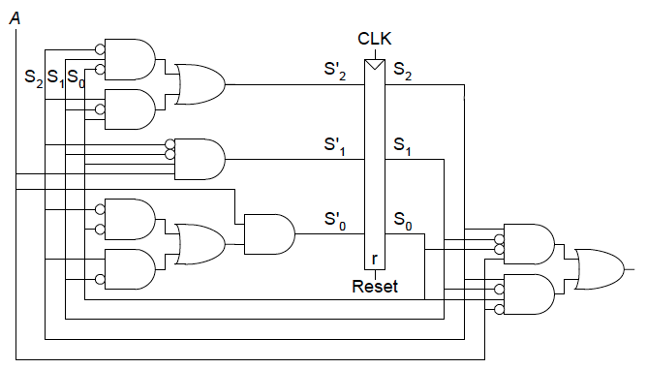
Result: Mealy FSM Schematic (PaperTape#2)
Next State Logic:
S₀’ = S₂S₀A + S₂S₁A
S₁’ = S₂S₁S₀A
S₂’ = S₂S₁S₀ + S₂S₁S₀
Output Logic:
Q = S₂S₁S₀A + S₂S₁S₀A

Slide 11
Timings

Slide 12
Timing
Remember:
Flip-flop samples D at clock edge
D must be stable when sampled
Similar to a photograph, D must be stable around clock edge.
Aperture time – during which the object must remain still for a sharp image to be captured.
The aperture of a sequential element – a setup time and a hold time, before and after the clock edge, respectively.

Slide 13
Input Timing Constraints
Setup time:
t_{setup} = time before clock edge data must be stable (i.e. not changing)
Hold time:
t_{hold} = time after clock edge data must be stable
Aperture time:
t_{a} = time around clock edge data must be stable (t_{a} = t_{setup} + t_{hold})

Slide 14
Output Timing Constraints
Propagation delay: t_{pcq} = time after clock edge that the output Q is guaranteed to be stable (i.e., to stop changing)
Contamination delay: t_{ccq} = time after clock edge that Q might be unstable (i.e., start changing)
Notes:
NOTE:
Compare with propagation delay (t_{pd}) and contamination delay (t_{cd}) of a logic gate – see earlier in the course.
Propagation delay and contamination delay on *this* slide are definitions of those terms for sequential circuits….
Propagation delay - This value indicates the amount of time needed for a change in the flip flop-clock input (e.g. rising edge) to result in a permanent change at the flip-flop output (Q). When the clock edge arrives, the D input value is transfered to output Q. The output of the flip-flop may be at an intermediate value for a while (indicated by the cross-hatched area) before the final output value is created. After t_{pcq}, the output is guaranteed not to change value again until another clock edge trigger (e.g. rising edge) arrives.
Contamination delay - This value indicates the amount of time needed for a change in the flip-flop clock input to result in the initial change at the flip-flop output (Q). The output of the flip-flop maintains its initial value until time t_{ccq} has passed. The flip-flop is guaranteed not to show any output change in response to an input change until after tcd has passed.

Slide 15
Dynamic Discipline
Synchronous sequential circuit inputs must be stable during aperture (setup and hold) time around clock edge.
Specifically, inputs must be stable:
at least t_{setup} before the clock edge.
at least until t_{hold} after the clock edge.

Slide 16
Dynamic Discipline
The delay between registers has a minimum and maximum delay, dependent on the delays of the circuit elements.

Slide 17
Setup Time Constraint (T_{c})
Depends on the maximum delay from register R1 through combinational logic to R2.
The input to register R2 must be stable at least t_{setup} before clock edge.
T_{c} ≥ t_{pcq} + t_{pd} + t_{setup}
t_{pd} ≤ T_{c} – (t_{pcq} + t_{setup})
Notes:
REMEMBER: t_{pcq} = time after clock edge that the output Q is guaranteed to be stable (i.e., to stop changing)

Slide 18
Hold Time Constraint
Depends on the minimum delay from register R1 through the combinational logic to R2.
The input to register R2 must be stable for at least t_{hold} after the clock edge.
t_{hold} < t_{ccq} + t_{cd}
t_{cd} > t_{hold} - t_{ccq}
Notes:
REMEMBER
t_{ccq} = time after clock edge that Q might be unstable (i.e., start changing)

Slide 19
Timing Analysis
Timing Characteristics
t_{ccq} = 30 ps
t_{pcq} = 50 ps
t_{setup} = 60 ps
t_{hold} = 70 ps
t_{pd} = 35 ps
t_{cd} = 25 ps
per gate
t_{pd} = 3 x 35 ps = 105 ps
t_{cd} = 25 ps
Setup time constraint:
T_{c} ≥ (50 + 105 + 60) ps = 215 ps
f_{c} = 1/T_{c} = 4.65 GHz
Hold time constraint:
t_{ccq} + t_{cd} > t_{hold} ?
(30 + 25) ps > 70 ps ? No!

Slide 20
Timing Analysis
Buffers added to the short paths:
Timing Characteristics
t_{ccq} = 50 ps
t_{pcq} = 70 ps
t_{setup} = 60 ps
t_{hold} = 70 ps
t_{pd} = 35 ps
t_{cd} = 25 ps
per gate
t_{pd} = 3 x 35 ps = 105 ps
t_{cd} = 2 x 25 ps = 50 ps
Setup time constraint:
T_{c} ≥ (50 + 105 + 60) ps = 215 ps
f_{c} = 1/T_{c} = 4.65 GHz
Hold time constraint:
t_{ccq} + t_{cd} > t_{hold} ?
(30 + 50) ps > 70 ps ? Yes!

Slide 21
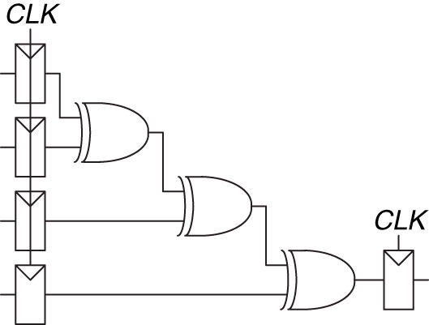
Timing Analysis - Example
Each two input XOR gate has a propagation delay of 100ps and a contamination delay of 55ps.
Each flip-flop has a setup time of 60ps, a hold time of 20ps, a clock-to-Q maximum delay of 70ps, and a clock-to-Q minimum delay of 50ps.
What is the maximum operating frequency of the circuit?

Slide 22
Timing Analysis - Example
Timing Characteristics
t_{ccq} = 50 ps
t_{pcq} = 70 ps
t_{setup} = 60 ps
t_{hold} = 20 ps
t_{pd} = 100 ps
t_{cd} = 55 ps
per gate
t_{pd} = 3 x 100 ps = 300 ps
t_{cd} = 1 x 55 ps = 55 ps
Setup time constraint:
T_{c} ≥ (70 + 300 + 60) ps = 430 ps
f_{c} = 1/T_{c} = 2.33 GHz
Hold time constraint:
t_{ccq} + t_{cd} > t_{hold} ?
(50 + 55) ps > 20 ps ? Yes!

